Slide 1
Paid Advocacy at Bike Shops or Using Active Advocacy to Boost Sales
Chris Clark, Events and Marketing Manager, Trek Bicycle Store of Mt. Pleasant, SC
ChrisC@SteinwayCharleston.com
Notes:
Show of hands: How many bike shop people do we have in here today?
How many non-profit people? Both? Thanks, that’s what I thought.
So we’ll go with ‘Paid Advocacy at Bike Shops’ today. I’ve worked on both sides. I’ve been the guy soliciting sponsorships and the guy getting requests for donation bikes every week. I want to share how I think we create better relationships between the two.

Slide 2
If Only I Had More. . .
Volunteers
Support from the community
Members
Friends in local government
Time
Money
Staff
Weekly Rides
Event Rides
Women-focused Rides
Bike Rodeos
Ride Support
Maintenance Classes
Women-focused Classes
Skills Classes
Safety Classes
Blinkey Lights
Notes:
Most of the time ‘scarcity’ defines a nonprofit. We never seem to have enough ANYTHING to fill the need. I saw this with the Baton Rouge Bike Club, with Bike BR, Bike Easy, Education Nonprofits in New Orleans I’ve worked with- you name it. Whether you’re a bronze or platinum BF City you’ll be wanting more [read slide] – and I’m sure I left some off- to address problems you’ve identified. ‘If we only had [all of these] then we do more [right side]. One way that I’ve been able to GET AROUND-not solve them, but get around- these needs is by rethinking my relationships between advocacy organizations and Local Bike Shops.

Slide 3
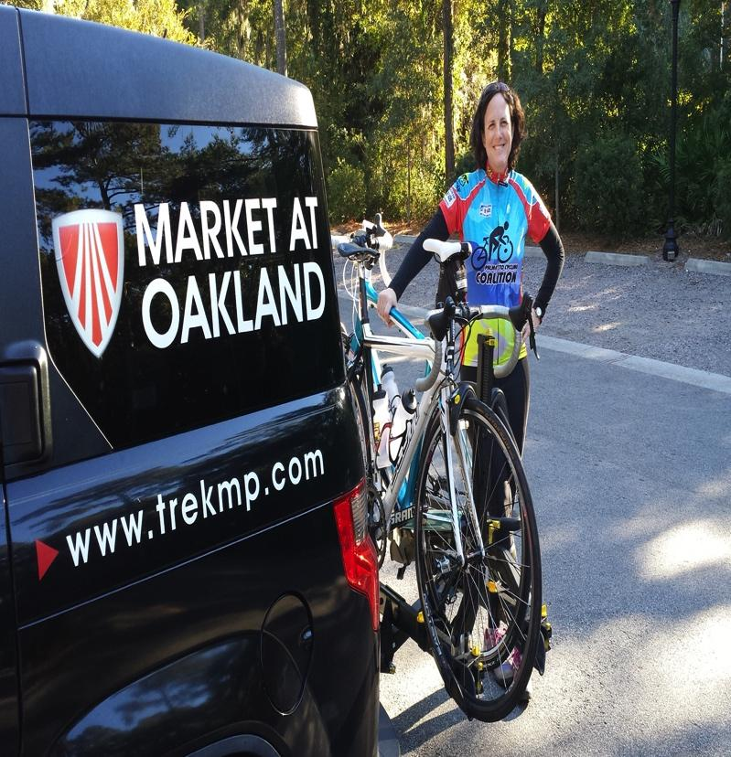
Rethink Your Relationship
Understanding Motivations
Advocate as Change Agent
Notes:
You may think you have a fine relationship with your local shops. They donate when they can and let you sit stuff on the counter, hang posters. Some shop guys might even show up for an event if you don’t have it on a Saturday.
If that’s 75% of your interactions you are missing out. To get more out of our relationship we have to recognize that Nonprofits are FUNDAMENTALLY different than businesses.
This is a picture I took on the SC State Rolling Summit the Trek Store Sponsored. I hate to say sponsor because we didn’t give money. What we did give was my salary for the week, gas, and the Trekmobile so that I could drive 638miles (give or take )to SAG for Amy Johnson, ED of the Palmetto Cycling Coalition, and Timmy Finch, of Bikelaw as they rode across SC training advocates. This is a pic of Amy taking her bike off the rack. Nice shot, huh? Took 5 tries to get the all the sponsor logos just right so we could post this on social media.
Understanding that is key to rethinking our relationship.

Slide 4
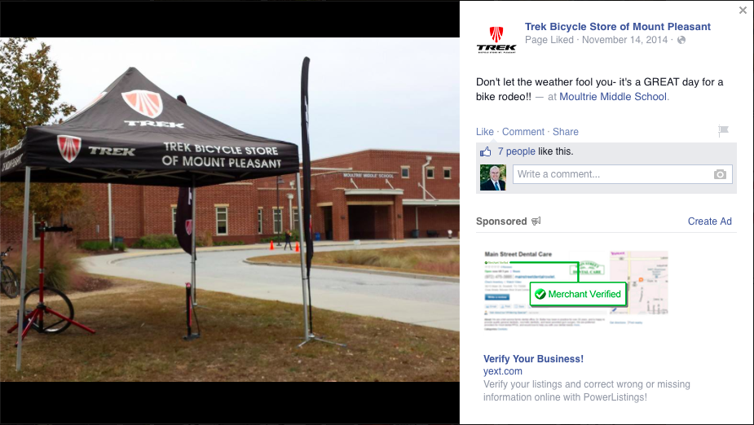
Understanding Bike Shop Motivations
Bike Shops are For-Profit, and that’s OK
Exposure
Foot Traffic
Sales
Notes:
I want you to take a moment to read this bullet point to yourself. *pause*
Now let’s all read it together…
Mr. Clements here will back me up when I say, and you may have heard this before, that people are not in the bike shop business to get rich. Shop owners, managers, and employees just want to make a living doing what they love, what we all love, working with bikes.
They need exposure to drive foot traffic into the store to make sales. This is a picture of my station at a local bike rodeo. Did I need the tent? NO! it was freezing and I would have welcomed a little sun. But this made sure 100+ kids, a dozen teachers and every parent in the carpool line saw the ‘Trek Bicycle Store of Mount Pleasant’. AND THAT’S OK

Slide 5
Understanding Bike Shop Motivations
Discounts
Advertising
Donations
Coupons
Sponsor
Participate
Notes:
When we think to ourselves, ‘How can the Bike Shops Support our organization and events’, most of us come up with the same things. %15 discount for members, donations for door prizes, a couple/few hundred to be on the club jersey or event banner.
If we’re honest with ourselves, do any of those things REALLY address the primary motivation of a bike shop, to drive sales? If anything we’re blackmailing them so they won’t be the ONLY shop not participating. In stead why don’t we ask them to Advertise our causes, Provide coupons, and be a part of events? I’m sure many of you do already or have shops that offer these services instead. That’s a good first step, but the other side of the coin is this. How do these help US with our work? Sure every little bit helps, but we’re being penny-wise and pound foolish. Remember the list of things we wanted earlier?

Slide 6
If Only I Had More. . .
Volunteers
Support from the community
Members
Friends in local government
Time
Money
Staff
Notes:
How much do Shop Donations, Discounts, and sponsorship impact these needs? Probably not much. How many FT staff can you pay from donations from local bike shops?
Lets get real about what we ask for versus what we need.

Slide 7
Understanding Advocacy Motivations
Sign-ups
Riders
Events
Causes
Flyers
Contact Lists
Notes:
We try to get a few more signups at our events by taking a couple flyers to the shops.
Is this what our mission statements say, we want slightly bigger events? All of the ones I’ve read talk about better infrastructure, safer conditions, making bicycling a part of everyday life. You may have weekly rides somewhere on a logic model to get there, but why not focus our resources on things directly correlated with our mission?
What we should be asking shops to do is create more riders, support our causes, and share contact lists. The average shop might have a hundred people walk in the door every day→ why isn’t every single customer joining our group? The same shops have contact lists with thousands, some with tens of thousands of names. Names of people who have proven they don’t mind spending hundreds, if not thousands or tens of thousands of dollars on equipment. Are these people being informed about how our work impacts their lives, about our advocacy alerts, causes, and events? Even if they are, do you know if the information they get is in line with your positions?

Slide 8
Local Bike Shop
Advocate on Payroll
More Programming
More Exposure
Higher Shop Revenue
More Mission-Focused Programs
Notes:
My big Idea is to for bike shops to see advocacy positions as essential as mechanics. This person can handle marketing, social media, website, and events too. These paid advocates will drive sales while supporting our causes.
It’s good for advocacy and It’s good for business.

Slide 9
Advocate as Change Agent
In the shop
Train Staff
Align Messaging
Increase Sales
Go-to event staff
Media Spokesperson
Notes:
Bike shops are community resources. The average person may not know about your local advocacy organization, but they’ve seen the sign for the Trek Store on their way to work. Customers use them as a resource for Best Practices, News organizations ask for interviews, even board members for your organizations walk in to ask for policy advice. Make sure all the staff is on the same page with best practices and local bike/ped policy agendas so the hundreds of people a week who walk into a store don’t walk out with contrary info.
After I started as Sales and Marketing manager we had 1 less mechanic/salesperson in the shop, yet we made goal every month (except for an exceptionally wet November) for the rest of the year and had a record-breaking December.
CHECK TIME

Slide 10
Advocate as Change Agent
In the community
Allies on committees
Represent business community
Programming opportunities
Notes:
Of course having another advocate on committees to back up your positions will help– especially when they ‘represent business interests,’ right? Let the businesses themselves tell local leaders about economic impact of policies and programs.
Now you have another quasi-staff member as well. Need volunteers for a SAG stop? Bike Rodeo? Imagine the resources you would have freed up to pursue equity initiatives, infrastructure requests, local lobbying, development-- if you had someone else—with your messaging—doing these jobs for you? Someone you trained, someone you trust, someone who believes in your mission.

Slide 11
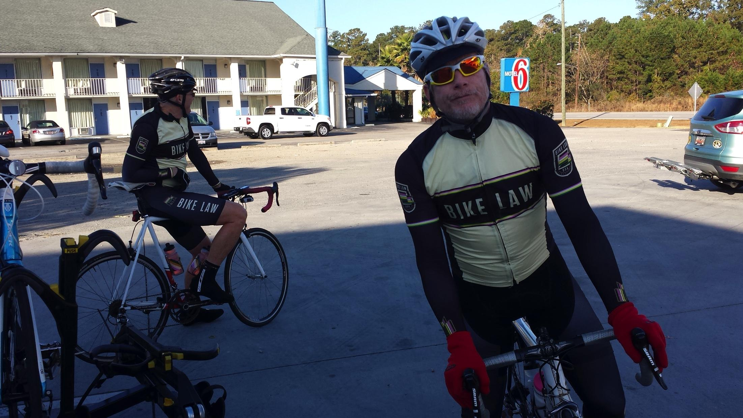
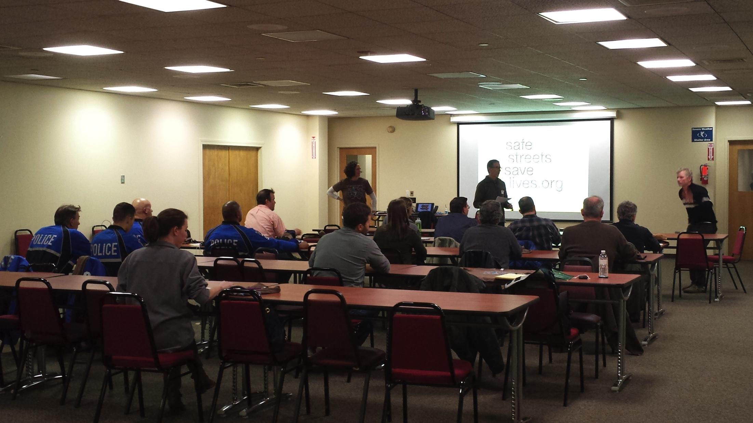
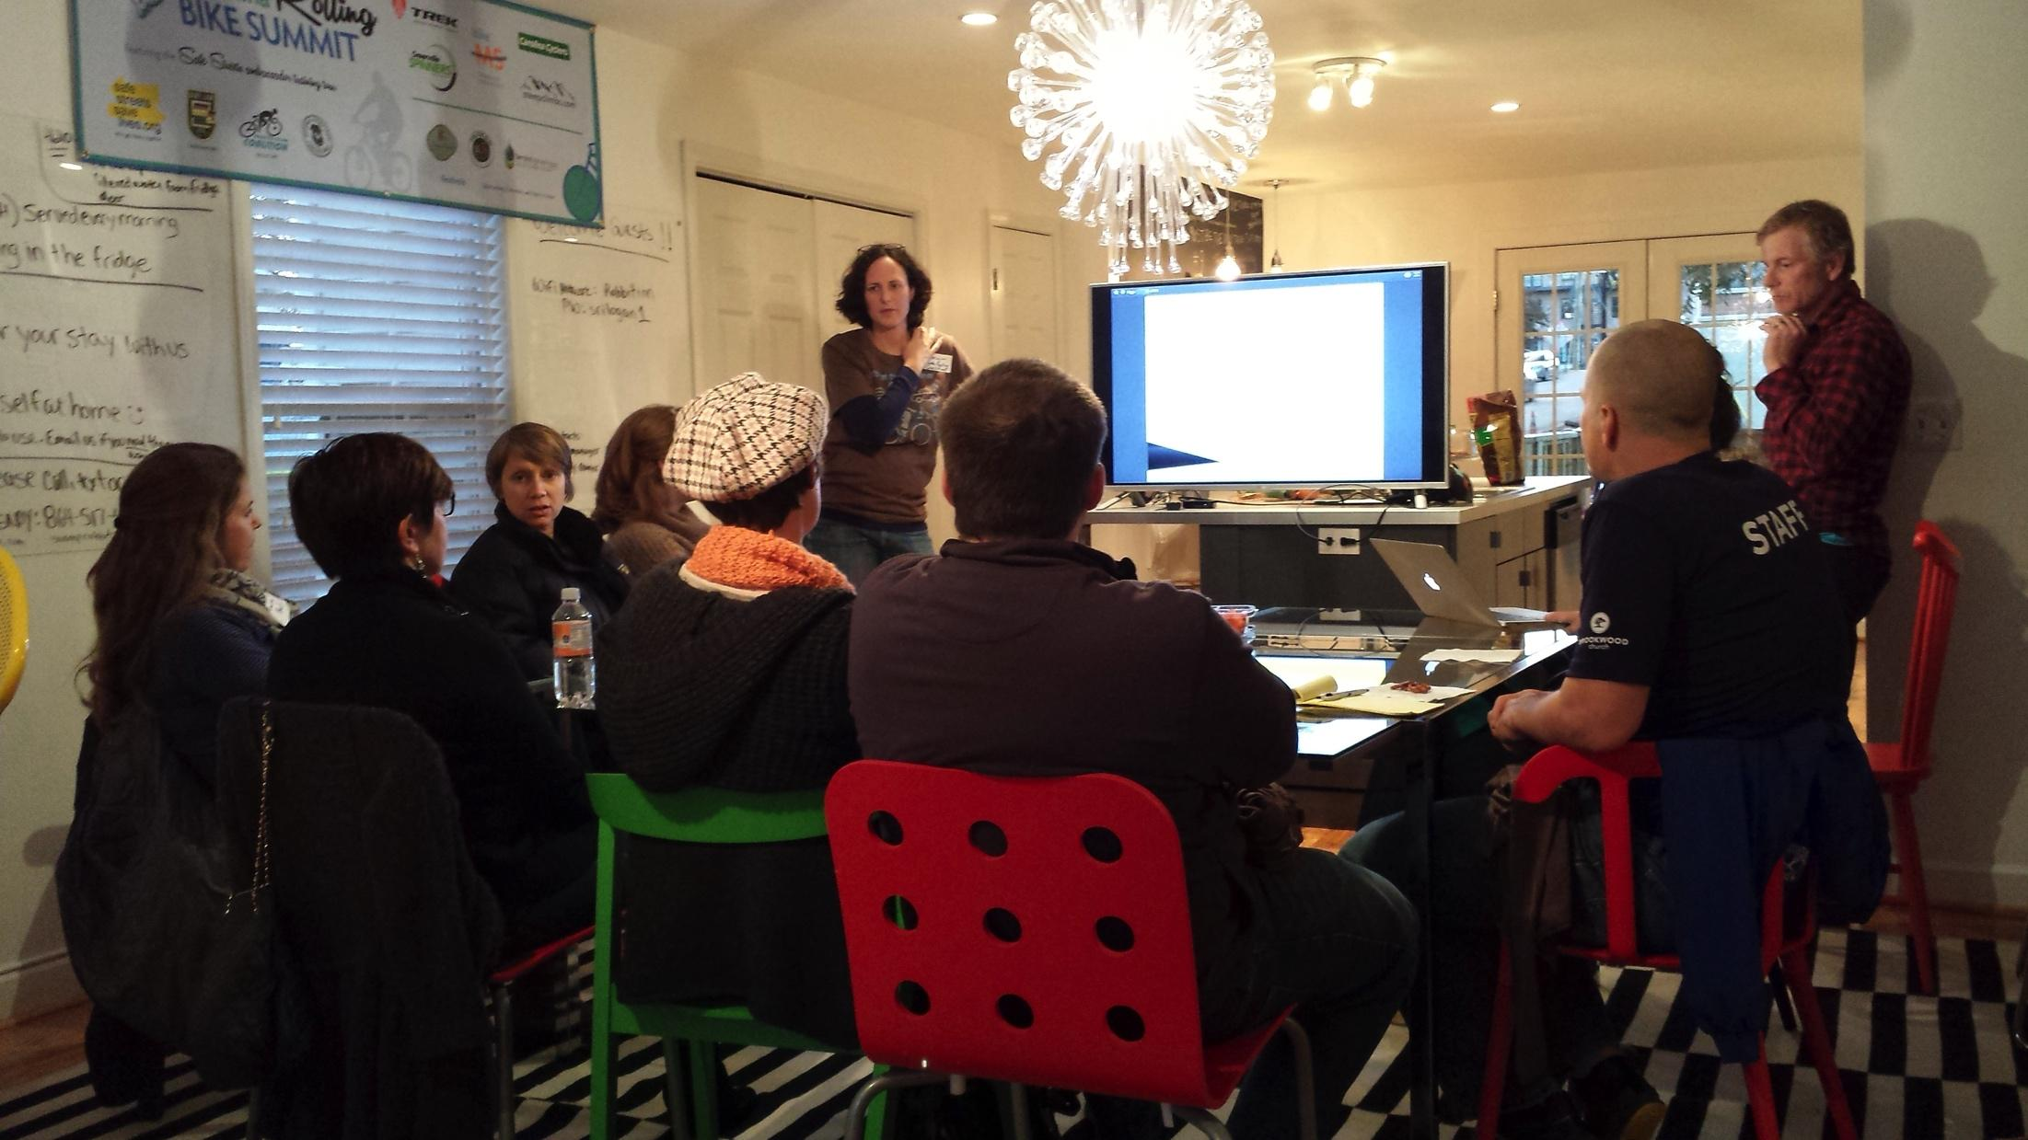
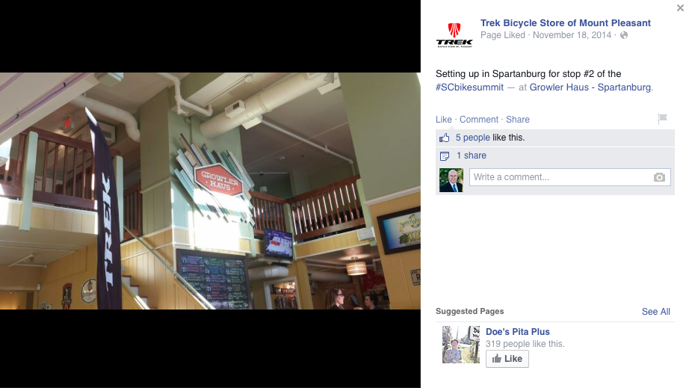
Lessons Learned

