Slide 1
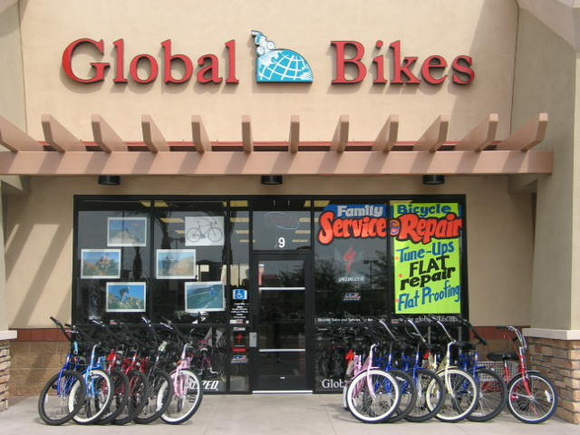
Bike Shops Are Cycling Infrastructure
Fred Clements
Executive Director
National Bicycle Dealers Association
fred@nbda.com

Slide 2
What is the National Bicycle Dealers Association?
Non-profit trade association
Board of Directors: 15 bike shops
1,300 member dealers out of 3,950 in existence
Publishes Bicycle Retailer and Industry News
Goals: education, research, advocacy for the independent bicycle dealer.
Promoting the passion for cycling.

Slide 3
Infrastructure:
The “underlying base or foundation for an organization or system.”
Places to ride (roads, paths, trails) are vital infrastructure.
Bicycles and equipment are infrastructure.
Locally available goods and services are also infrastructure: properly assembled bikes, accessories, test rides, repair, service, advice.
Existing cyclists and NEW cyclists need the local dealer.

Slide 4
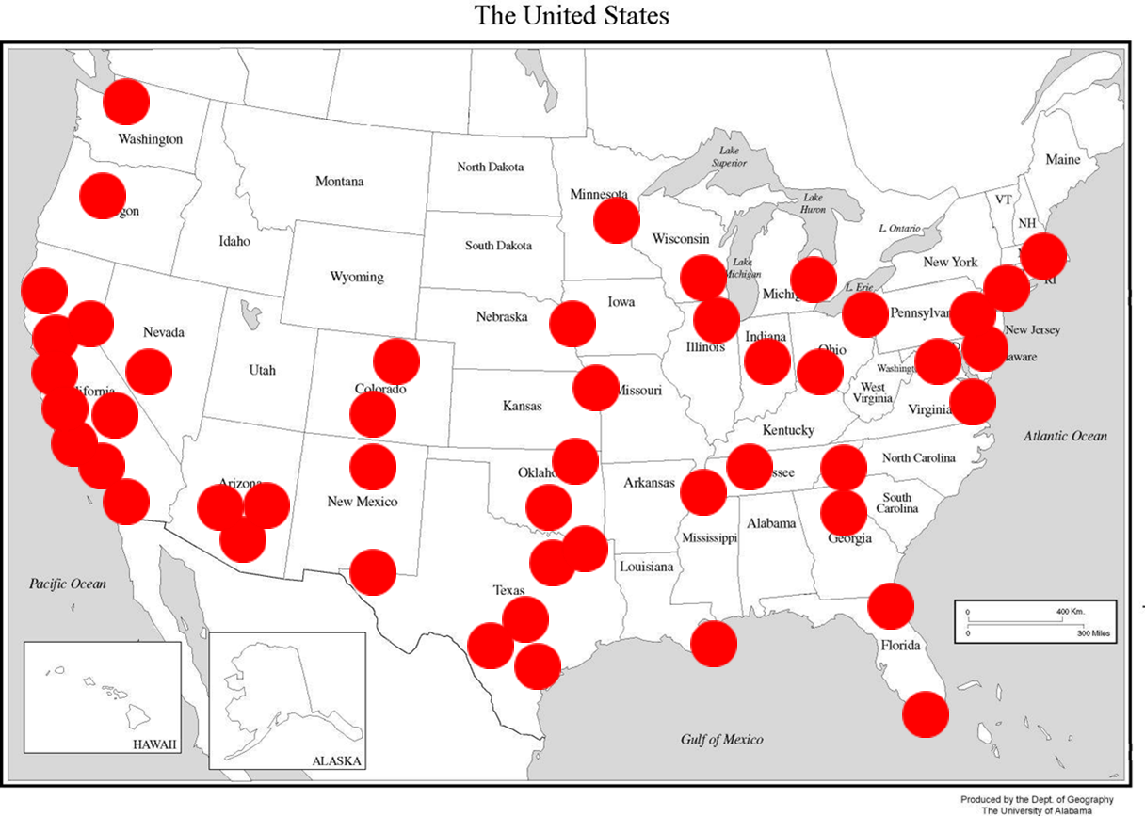
1985: 9,000 shops

Slide 5
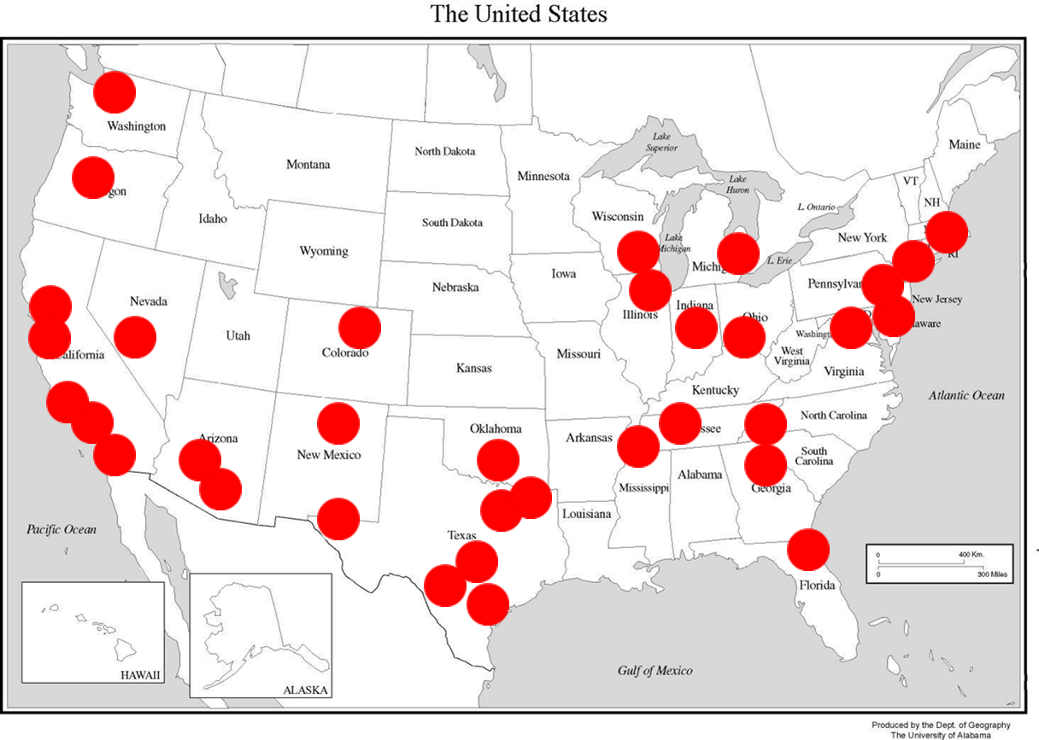
2000: 6,000 shops

Slide 6
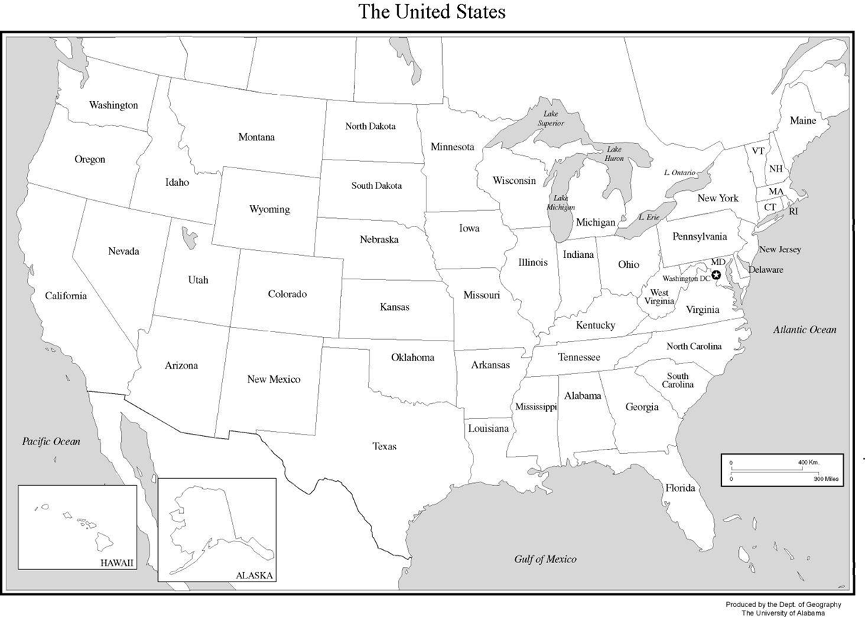
2015: 3,900 shops

Slide 7
All About Bike Shops: Main Street Retailing
Bike shop owners are diverse in backgrounds, motivations
88% have one location, national chains are few
Average years in business: 30.4
Average dollar volume ($997,761), 8 employees
Generation of owner: 66% Baby Boomers (ages 48 to 67)
Husband-wife teams, 32%
Average owner’s annual salary $49,887

Slide 8
Challenges Facing Bicycle Retailers
1 shop per 25,000 people in 1980
1 shop per 47,000 in 2000
1 shop per 83,000 in 2015
More price sensitive consumers
More competition from on-line retailers
Commoditization from brands that do not control distribution
Sales tax inequity
Flat overall sales from the channel

Slide 9
The Price and Margin Challenge
Average Cost of Doing Business (rent, salaries etc.): 38% of gross sales
Average profit margin on new bicycle sales: 35%
Average profit margin on parts and accessories: 46%
Bike sales below the CODB mean they sell at a loss, with P&A making the difference
Average profit for a bike store: 5.7% ($55,689)
Many dealers are on the edge of disappearing; many have disappeared.

Slide 10
The big idea: bike shops as infrastructure, why should you care?
More than a business issue: the future of cycling and bike shops are directly linked.
Cycling is an ecosystem; each part plays a role.
Fewer shops = less support and access = fewer cyclists.
New and existing cyclists need a local source of goods and services the Internet cannot provide.
Smaller towns without shops already have less participation.
Many stores are on the edge of disappearing.

Slide 11
What you can do
Demand excellence but support your ecosystem.
Vote with your dollars; make a conscious choice when you buy.
More dollars spent locally stay in your town.
Shops pay taxes, provide jobs, purchase local services, no cost to the taxpayer.

