Slide 1
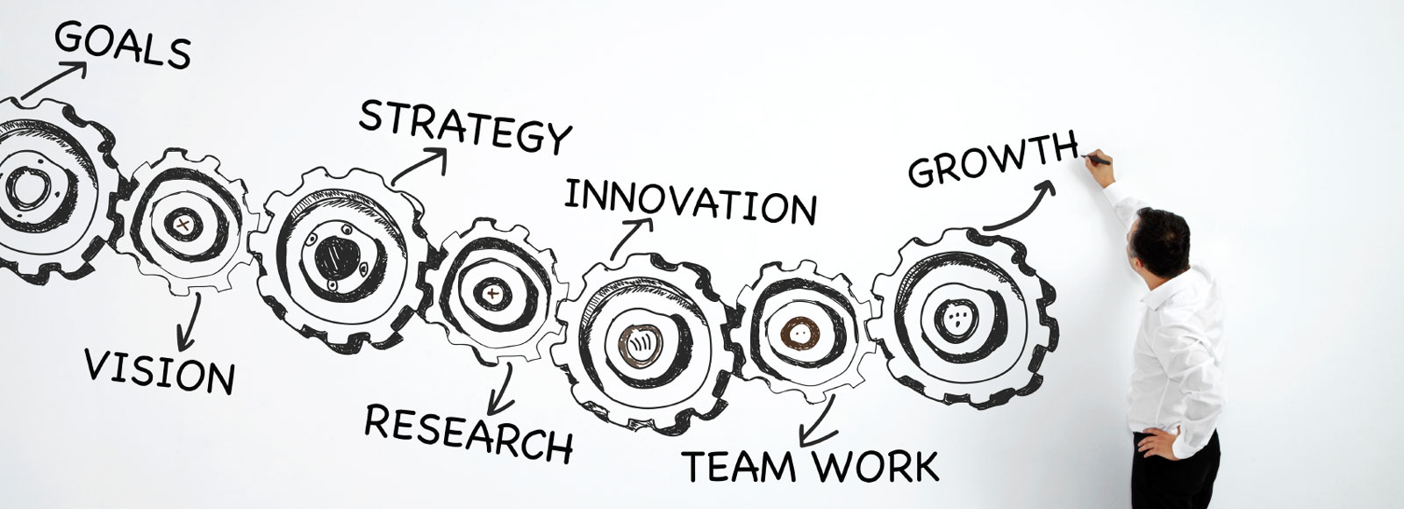
Making the Bicycle Retailer and Supplier Voice Count

Slide 2
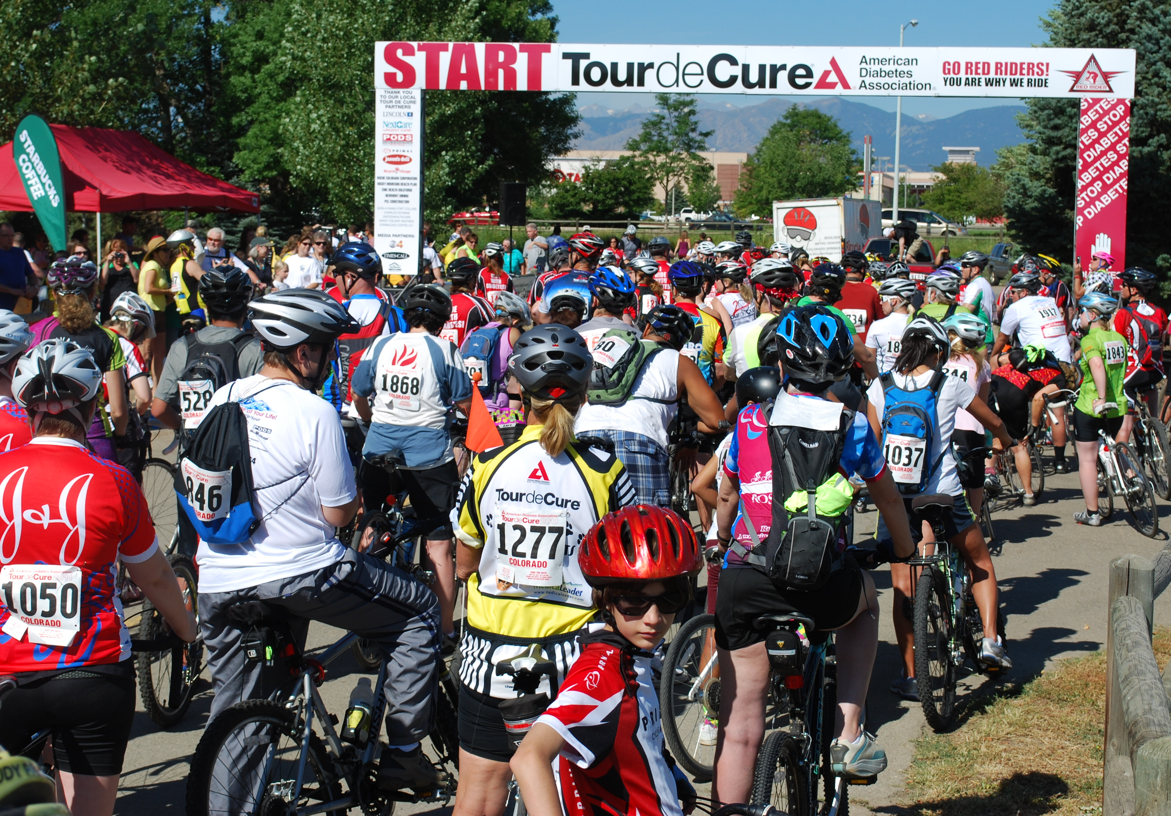

Slide 3
Signature Fundraising Cycling event of the American Diabetes Association
One day rides with multiple route options for every cycling ability
85 Events in 44 states
61,000+ participants
Raised $29 million in 2014

Slide 4
Why We Ride

Slide 5
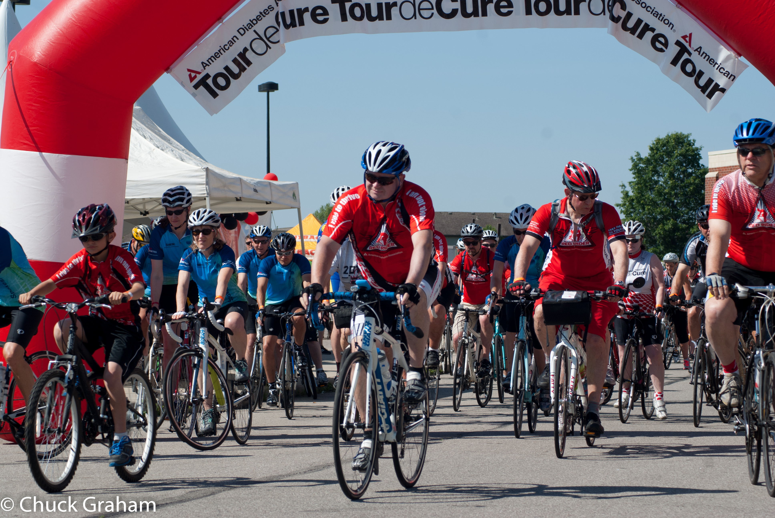
Why We Ride

Slide 6
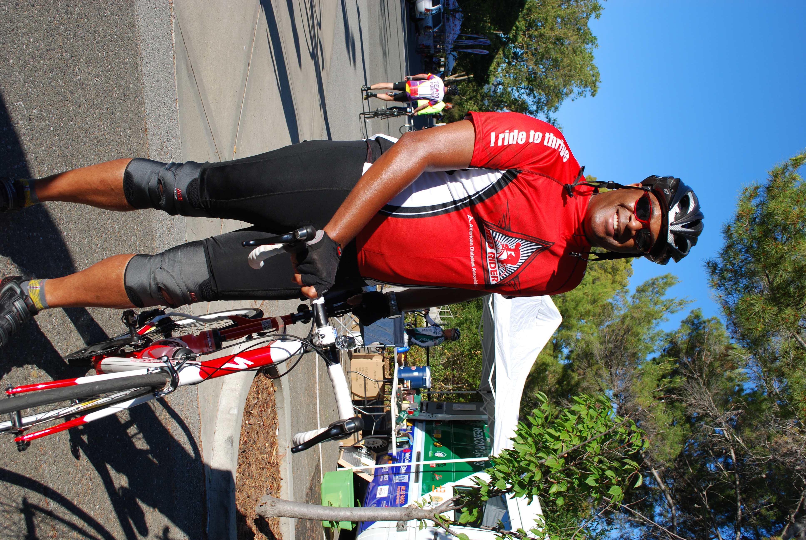
Why We Ride

Slide 7
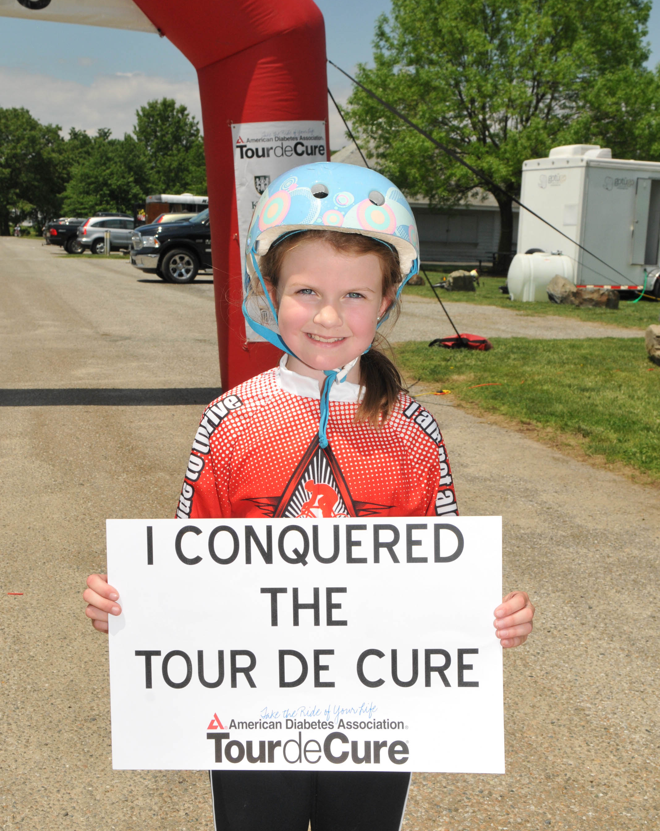
Why We Ride

Slide 8
Why do we Ride?
29.1 million American adults and children have diabetes
86 million more have pre-diabetes
Incidence is growing at an alarming rate; 1.7 million new per year
Economic cost is $245 Billion

Slide 10
Pathetically low thread count
Complicated pajamas
Which charity ride to support

Slide 11
Working with Retailers
What are your needs?

Slide 12
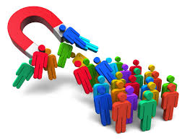
Acquisition

Slide 13
Key to Success
Relationship Building
Determining Needs
Aligning Goals
Providing Value

