Slide 1
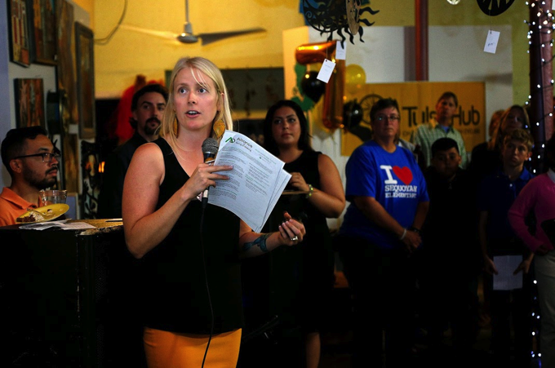
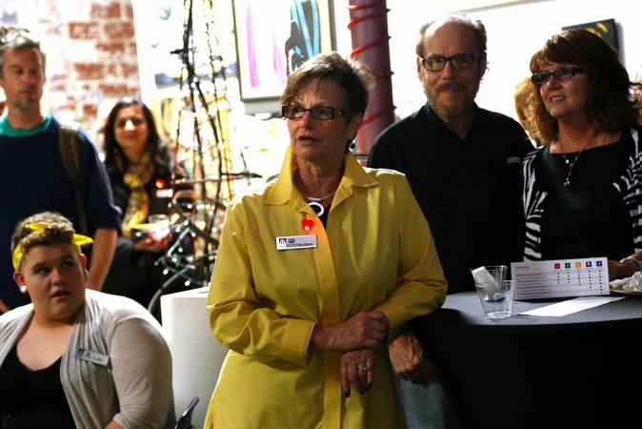
A Case Study in Leadership How Mentorship and Bold Leadership Grow the Tulsa Hub Mission Capacity
Ren Barger,
Tulsa Hub Founder/CEO
League Cycling Instructor #1761
Barbara Bannon,
Tulsa Hub Board/Immediate Past President,
Founder, Human Resource Investments

Slide 2
Welcome! What We Intend to Share
The creation story of Tulsa Hub.
Our experiences, surprises, and challenges of moving through organizational dreams to nightmares and onto awakenings.
Our understanding what a Healthy Organization means.
Our decisions to partner as strong leaders, without destructive competition.
Insights that could inform your future efforts.

Slide 4
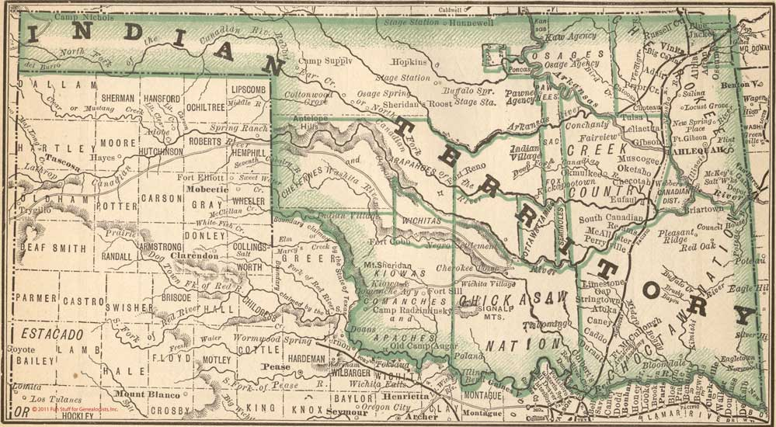

Slide 5
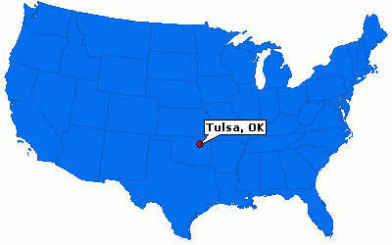

Slide 6
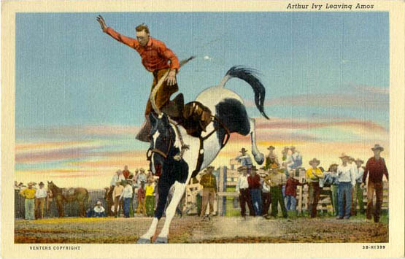
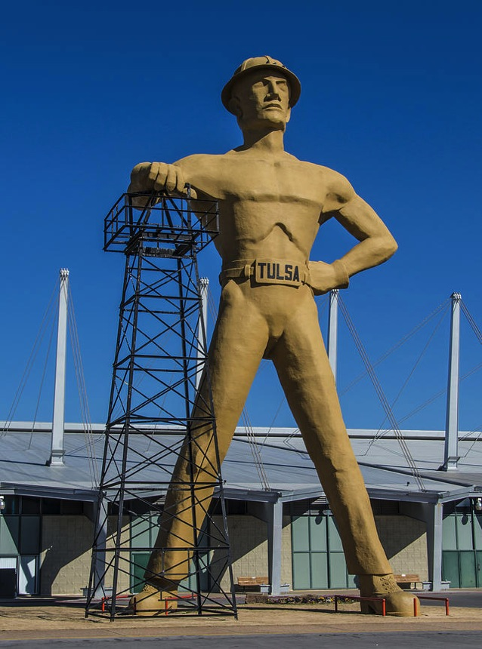
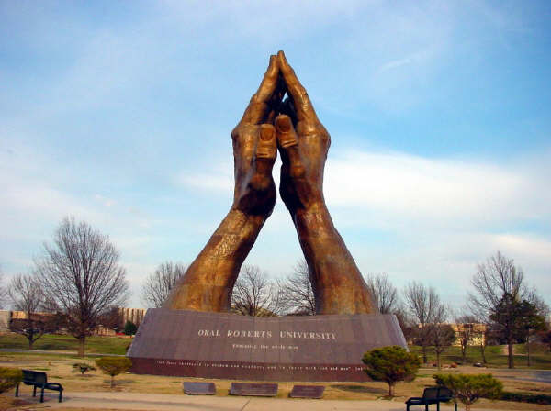

Slide 7
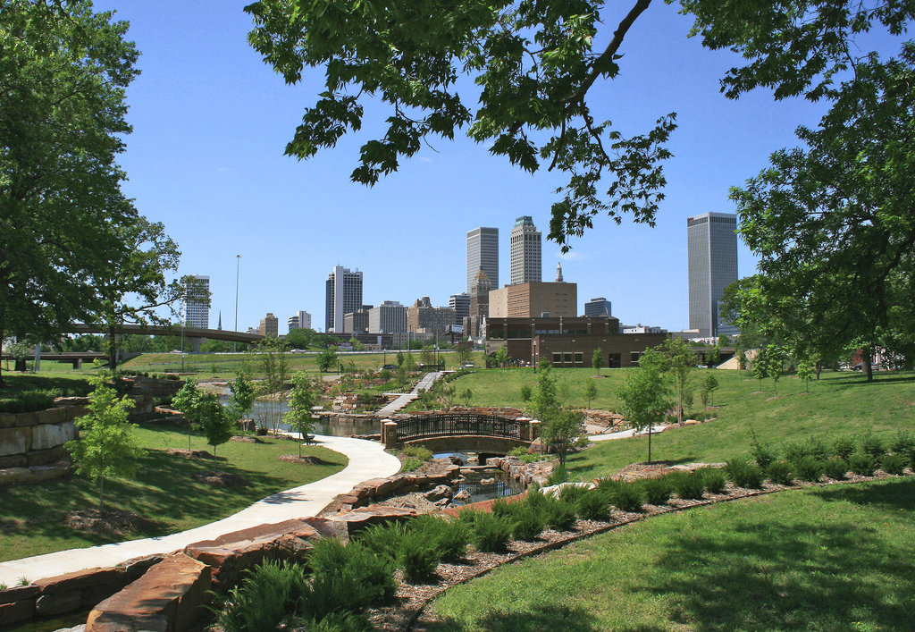

Slide 9
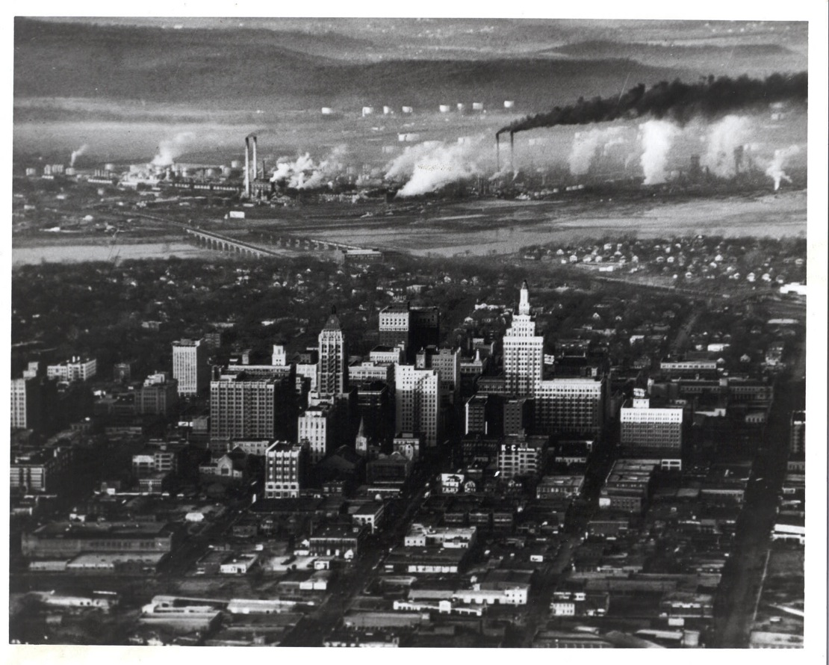

Slide 11
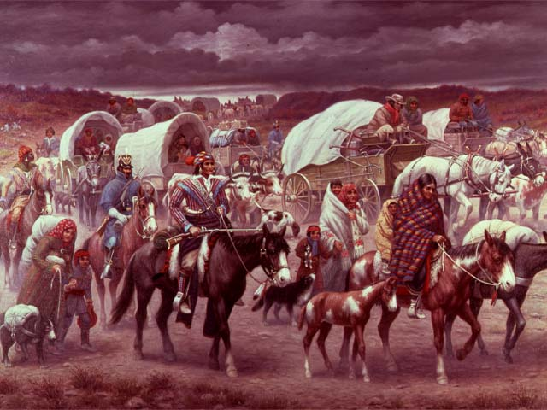

Slide 12
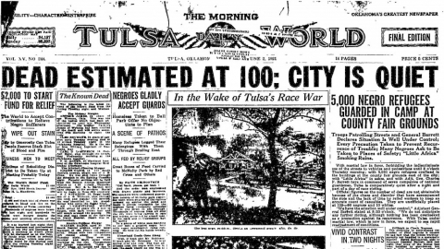
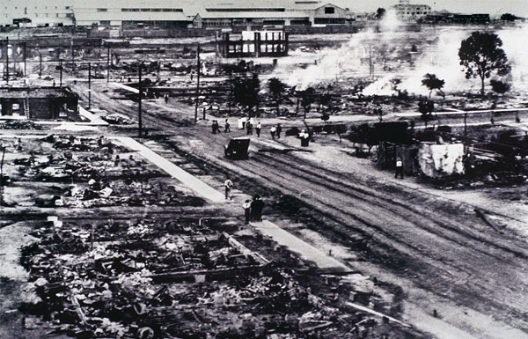

Slide 13
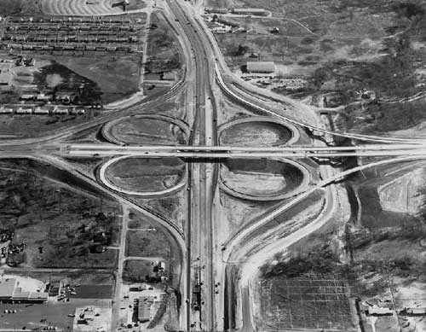

Slide 14
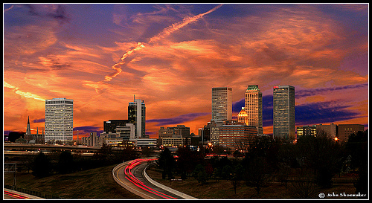

Slide 15
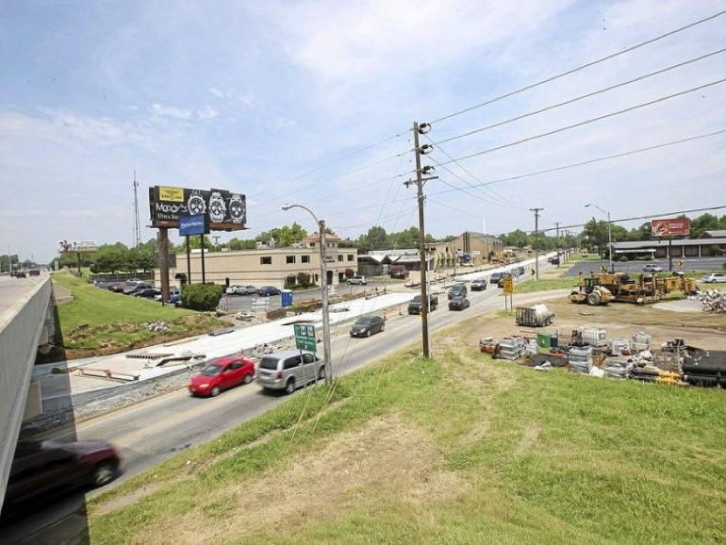

Slide 17
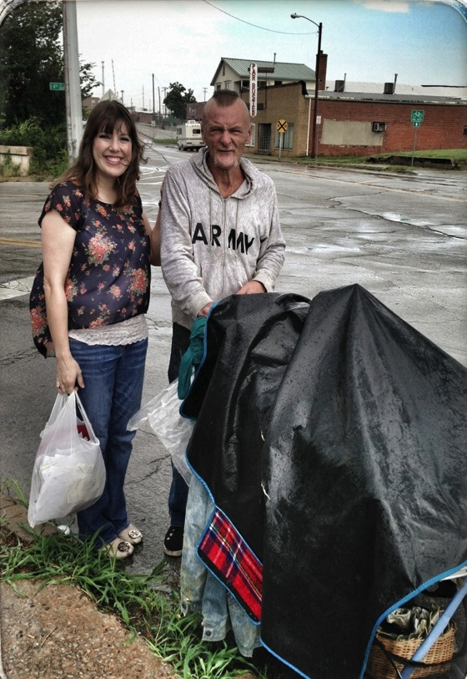
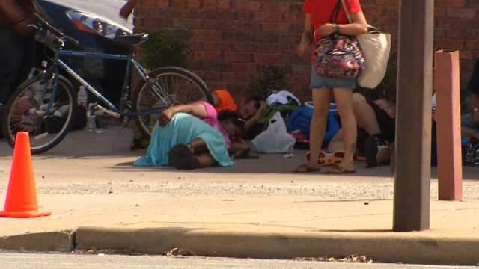

Slide 18
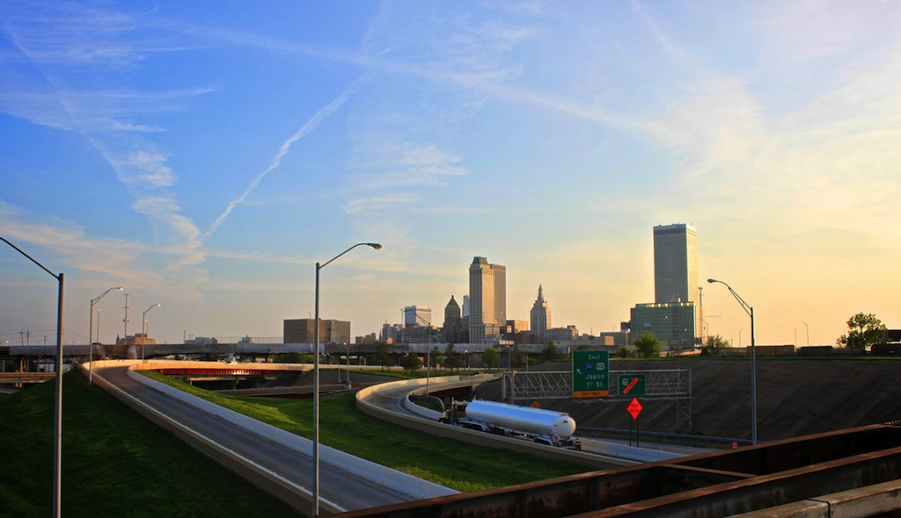

Slide 20
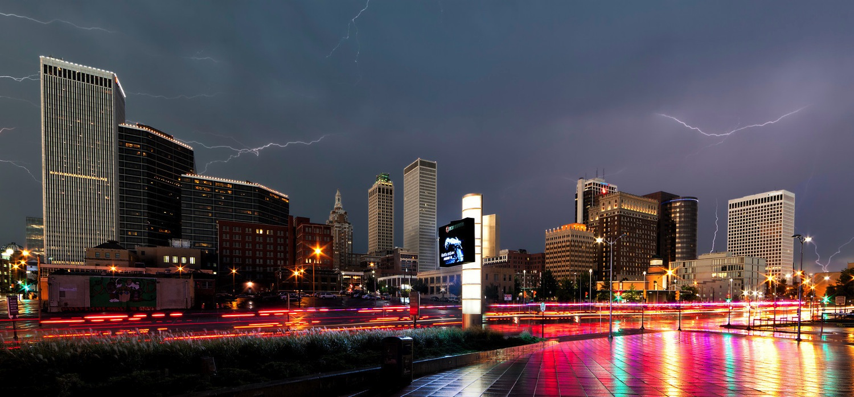

Slide 21
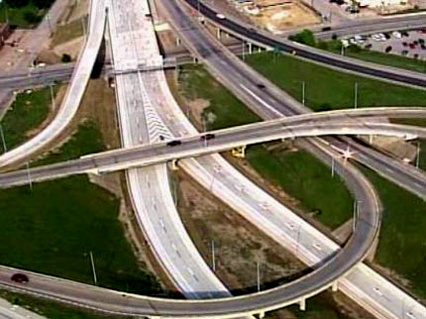

Slide 22
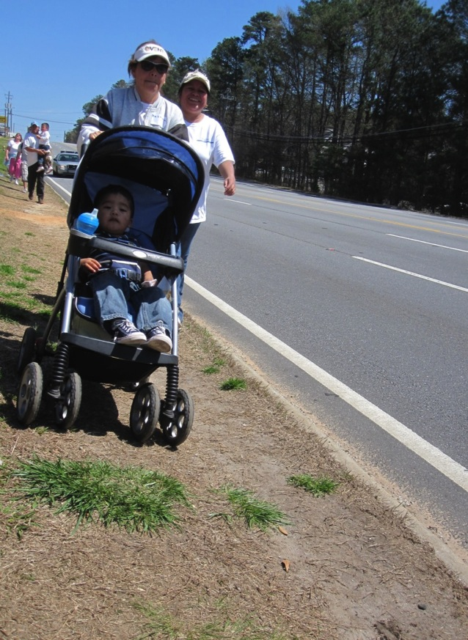
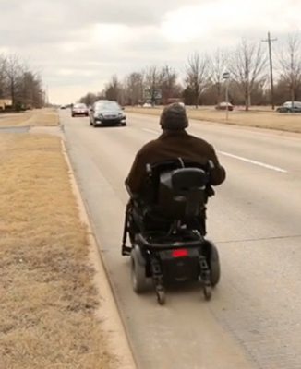
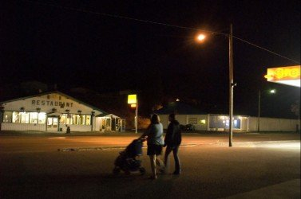

Slide 23
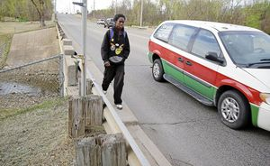
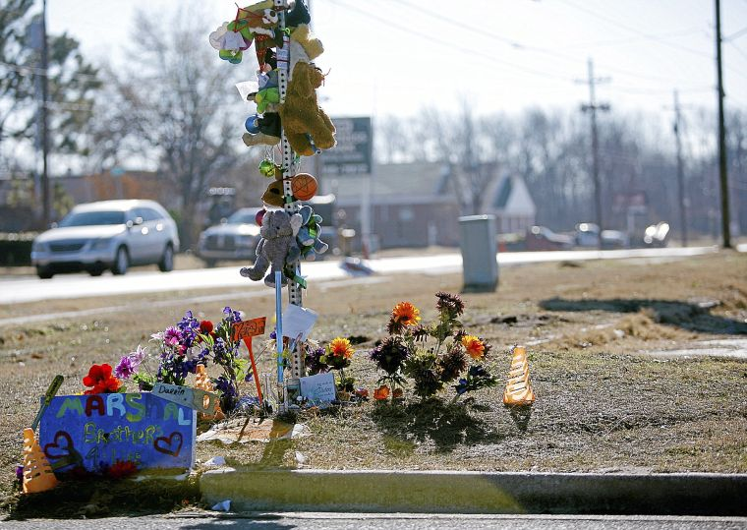
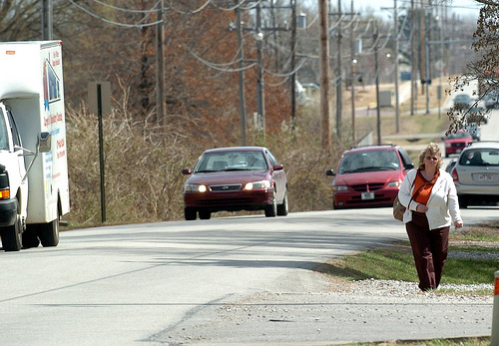

Slide 25
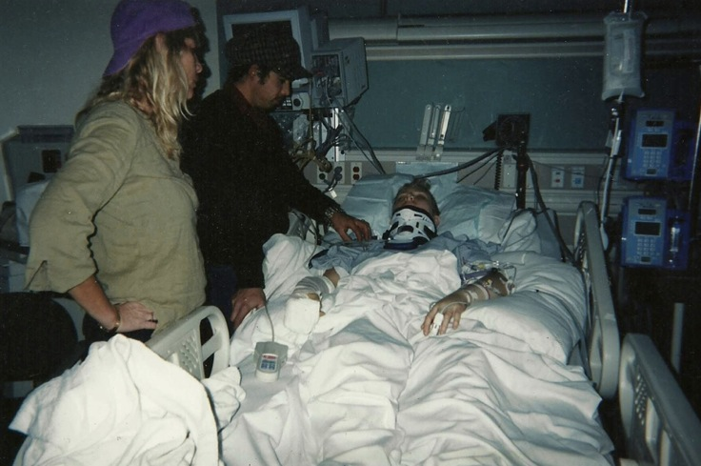
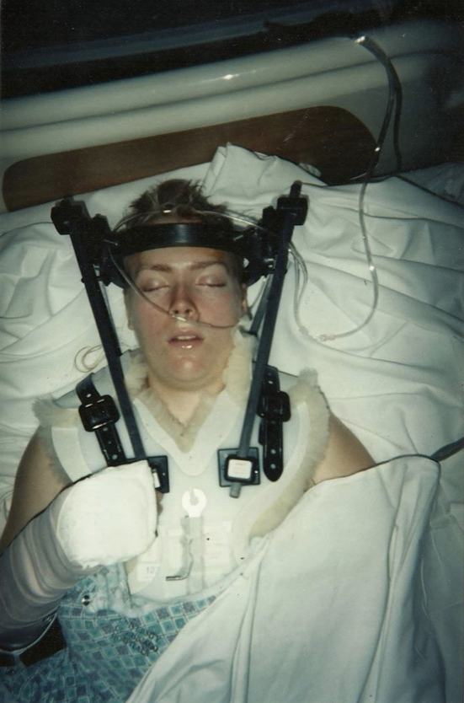
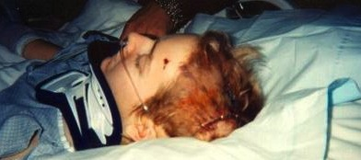

Slide 26
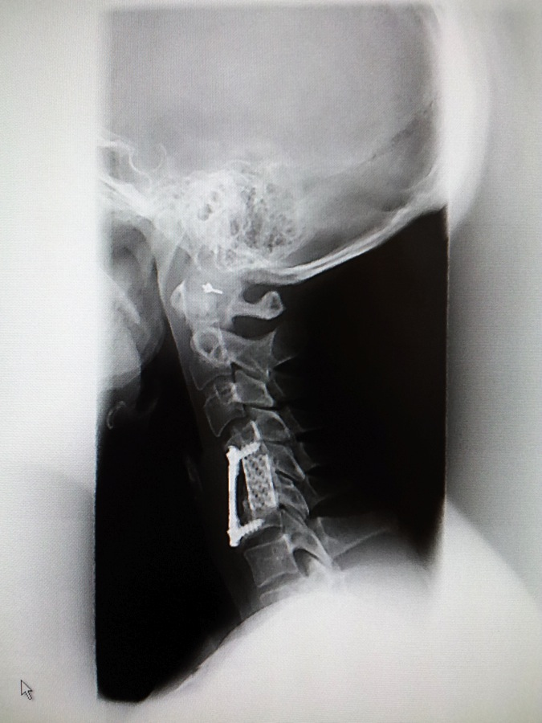
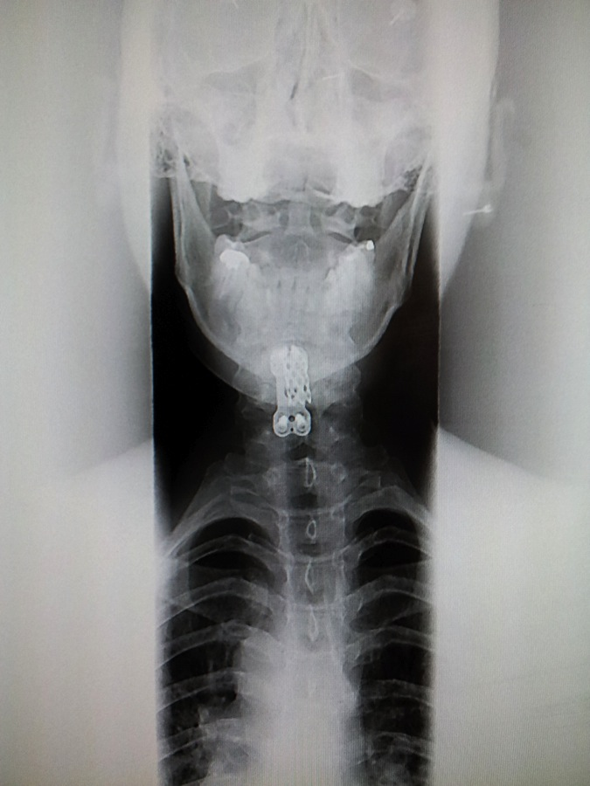

Slide 27
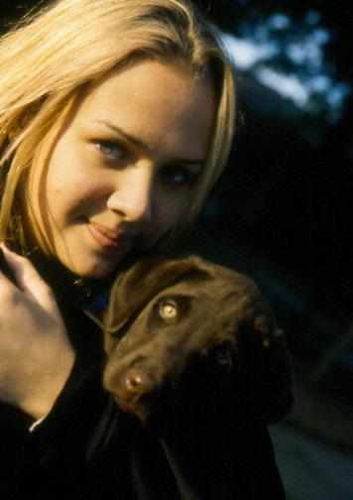

Slide 28
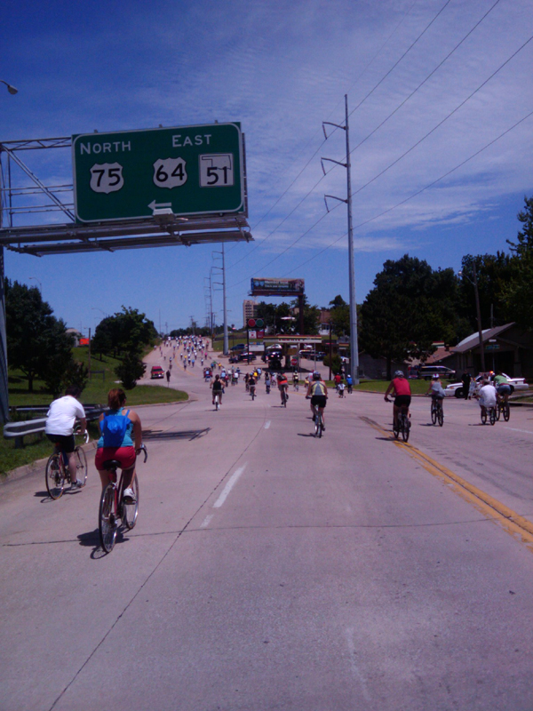
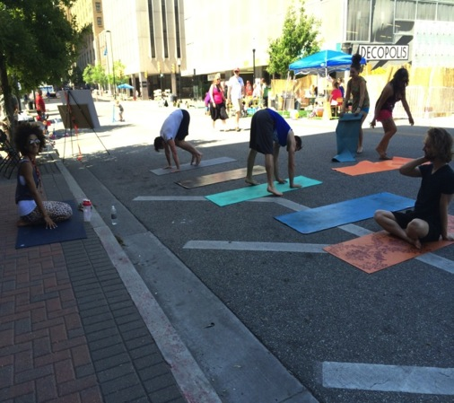

Slide 30
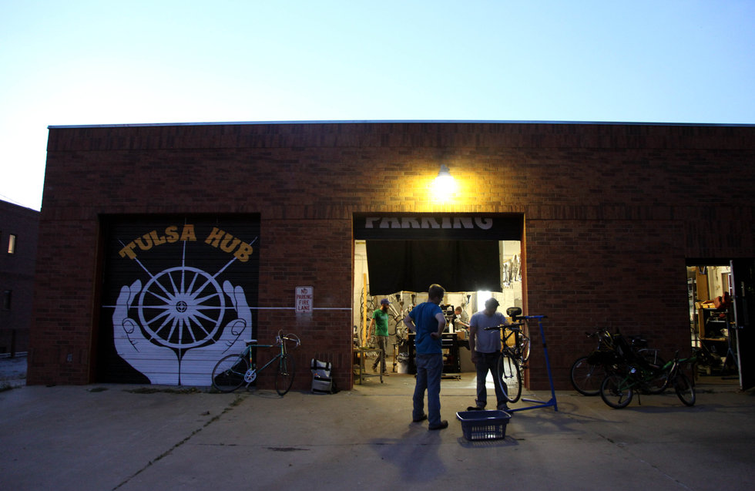

Slide 31
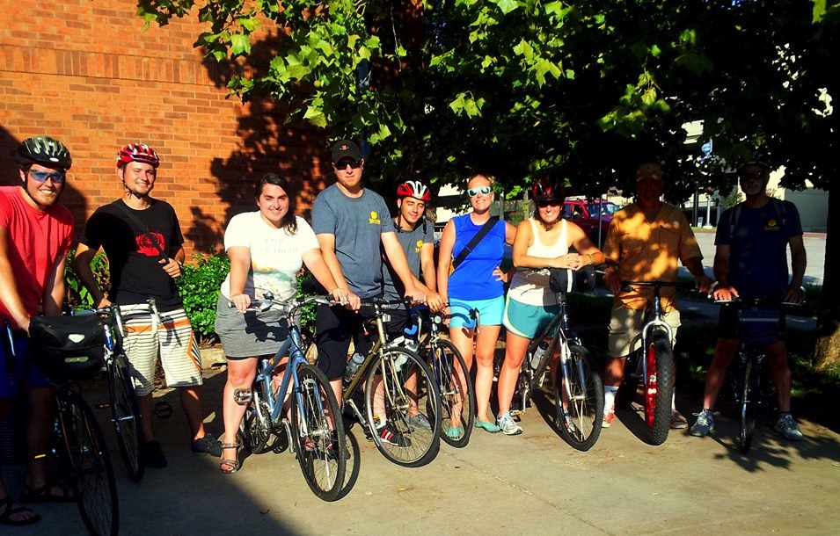

Slide 32
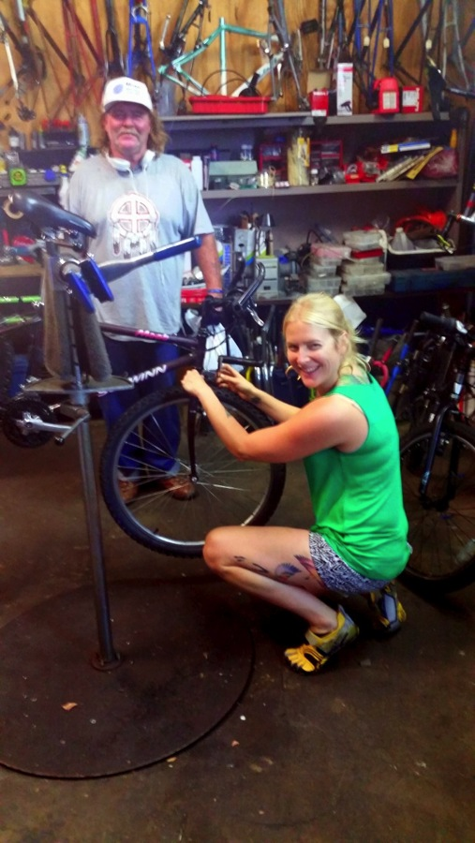
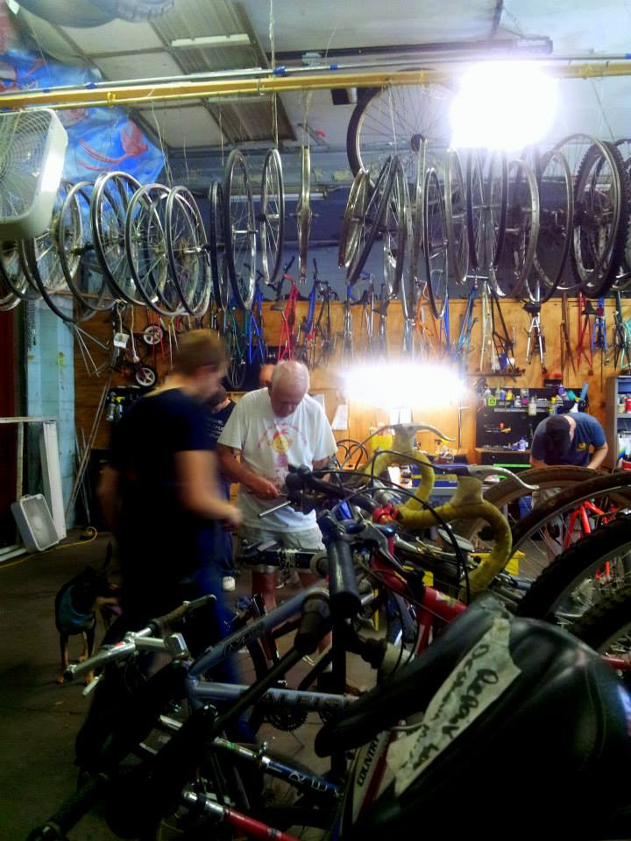
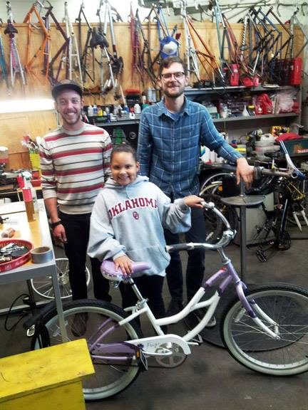

Slide 33
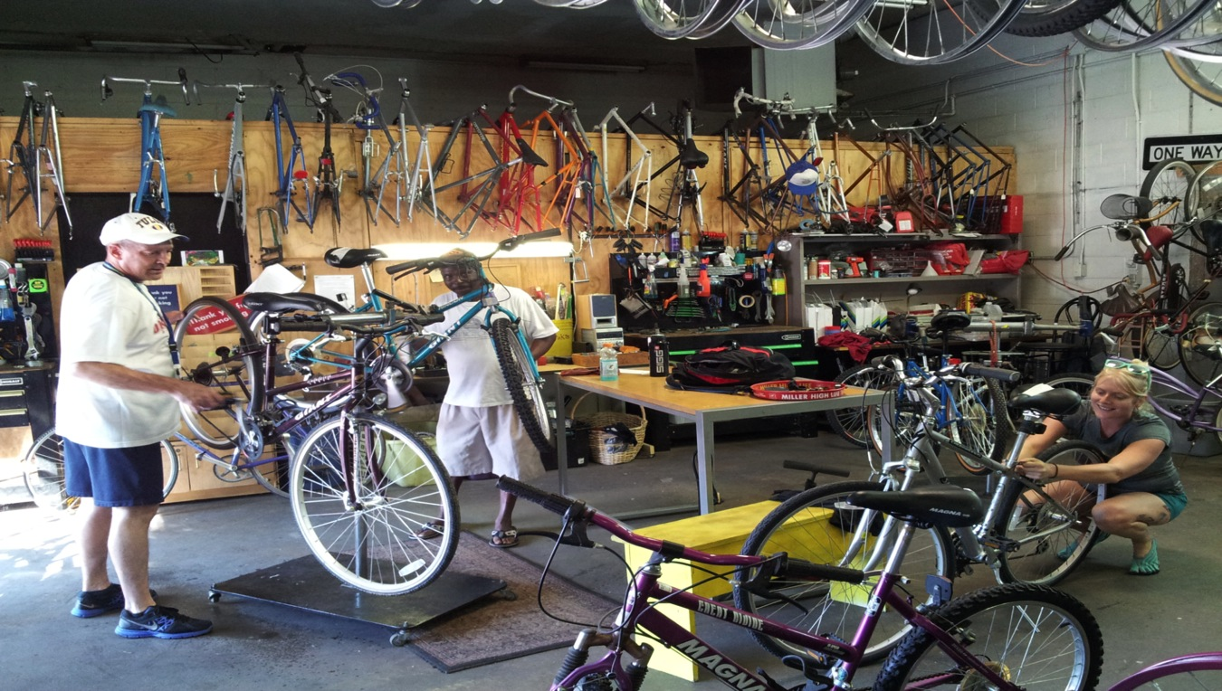

Slide 34
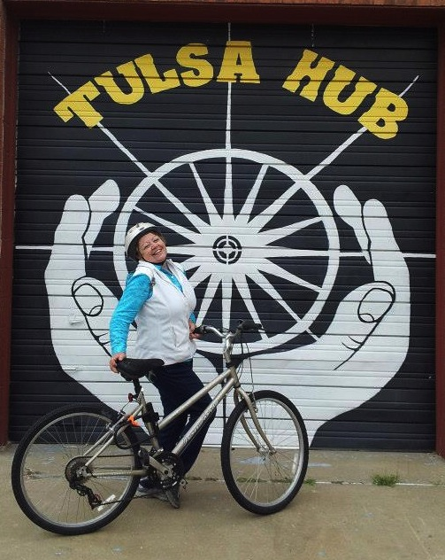
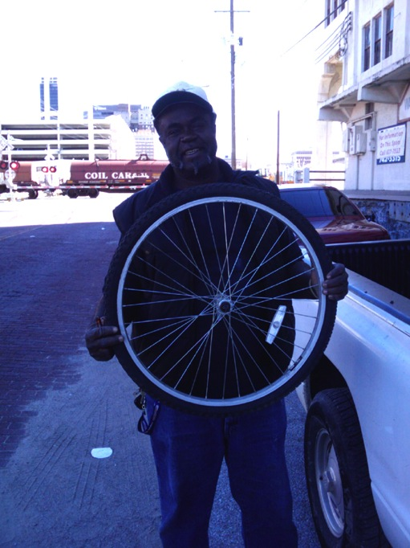
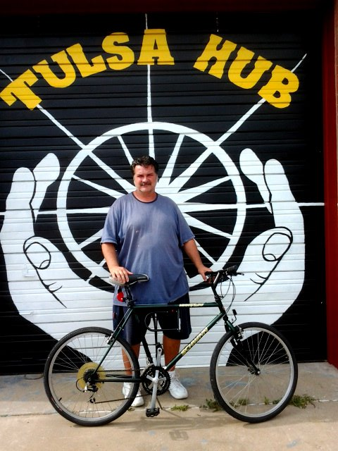

Slide 35
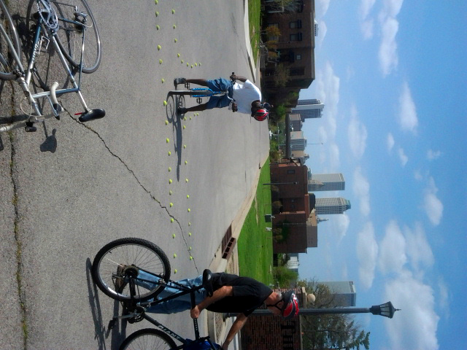
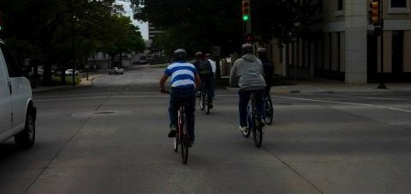
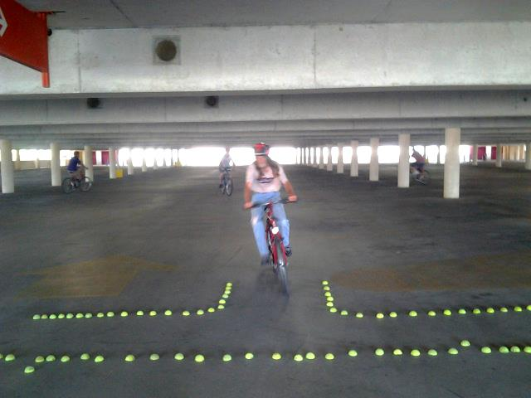

Slide 36
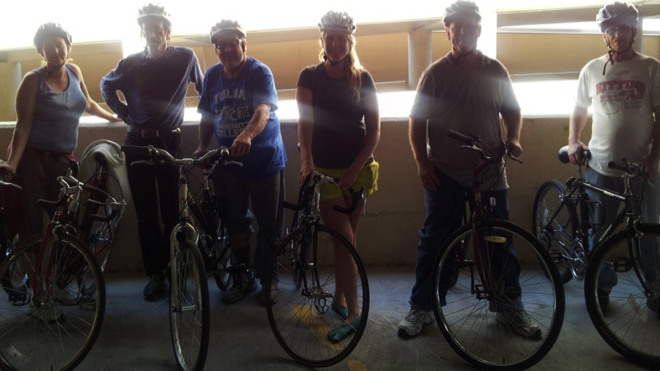
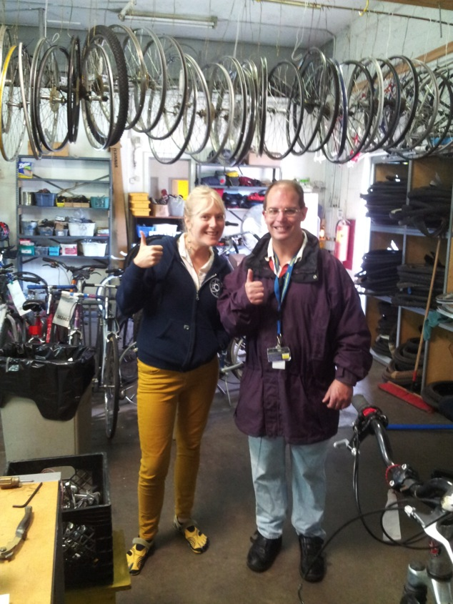
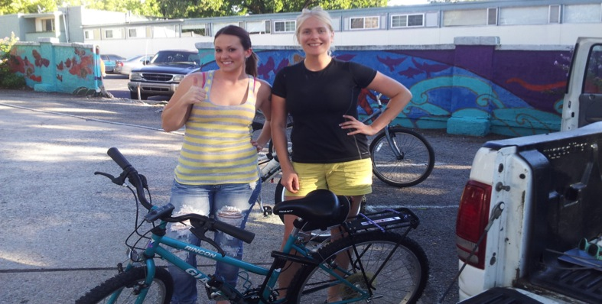

Slide 37
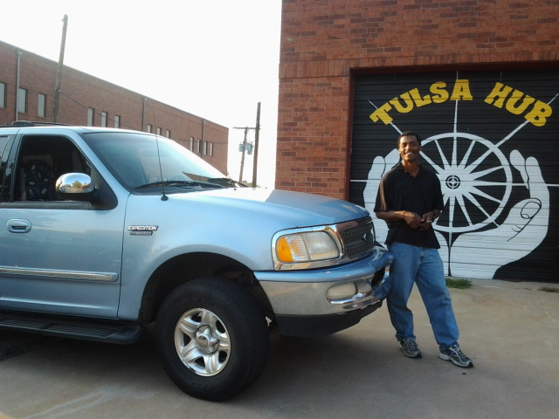

Slide 54
Barbara Bannon
Tulsa Hub Board Immediate Past President,
Founder, Human Resource Investments

Slide 55
Barbara’s Impressions and Feelings as a Consultant and Potential Mentor

Slide 56
Our Guiding and Shared Vision: Stabilize and Grow a Healthy Organization

Slide 57
Awareness proceeds choice; without awareness, there is no choice.

Slide 58
Classic Characteristics of an Unhealthy Organization
Low trust and fear
Infighting
Lack of direct communication (people talking about vs. with one another)
Little ownership of the needed organization structure and processes to support the programs
Lack of role clarity
Overall lack of healthy behavioral norms

Slide 59
Our Definition of “Healthy” Included:
Identify norms of acceptable/desired behaviors to guide our relationships with each other, board, volunteers, participants, and staff:
Be open and be honest
Ask for permission to give feedback
Presume innocence
Listen
Respond instead of react

Slide 60
Our Definition of “Healthy” Continued:
2) Recruit people with particular experience, skills, and commitment to achieve results.
3) Document an organization structure that would support a growing organization.

Slide 61
Our Definition of “Healthy” Continued:
4) Establish foundational tools needed to guide us into the future and attract good people:
bylaws
job descriptions and
other HR components
commitment forms
financial controls

Slide 62
We Focused on Structure, Organization & Norms Because This is What We Know:
“We are influencing others all the time, every time we’re around them. If you want people who are attracted to chaos and disorganization then behave in a chaotic and disorganized manner, but if you want the opposite then provide the opposite to attract what you want and need.
Healthy people are attracted to healthy organizations, unhealthy people are attracted to unhealthy organizations.”

Slide 63
Some of the Big Challenges and How We Handled Them
1) Finding the Right People
2) Creating a New Culture
3) Losing Board Members and Key Volunteers

Slide 64
How Do You Influence Board Members & Staff to Share A Common Vision & a Participative Style of Leadership
Recruit for the kind of people who are attracted to this type of environment.
Through a teambuilding and interactive planning process.
You market the organization as participative and thoughtful; tell your story and encourage questions.
Be congruent, talk the talk/walk the walk; do what you say you are going to do, be what you say you are going to be.
Tell the truth.

Slide 65
Where We Are Today and Our Goals for the Future

Slide 66
Organization structure is the solid foundation that is needed/required to create the safe environment that will allow people to be bold, take risks, and be creative!
Barbara Bannon

Slide 67
Thank You! Please Keep in Touch!
Ren Barger, Tulsa Hub Founder/CEO
ren@tulsahub.org
773-744-1613
Barbara Bannon, Founder, Human Resource Investments
barbara@humanresourceinvestments.com
918-299-5227

