Slide 1
Two Way Street
Stories of Change from Inside the Peloton
Nicole Freedman
Director of Bicycle Programs
City of Boston
Nicole.freedman@boston.gov
Notes:
Tell about my background racing
Gender issues

Slide 2
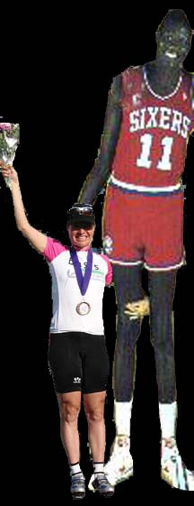
Manute Bol and me

Slide 3
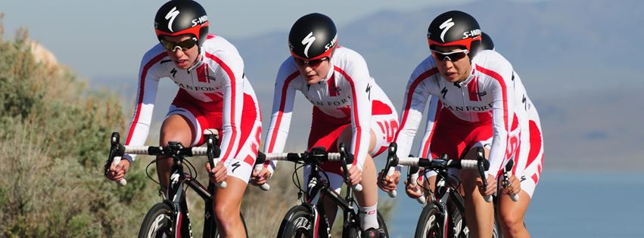
Stanford Cycling
Notes:
Fell in love with racing. Grades dropped

Slide 4
Parents Dream Child
Notes:
Called parents.
NBA
No women’s professional sports

Slide 5
Actual First Year Results
Redlands- Last
Visalia – Last
Tour Pont - DNF
NYC Crit - crash
HP- 2nd to last
Philly - 2x crash
Nationals - 2x crash
Notes:
Slow rise

Slide 6
Notes:
1996 good year. 0 trials

Slide 7
Notes:
Pro team, bought house. Salary $15/race day for food, up to $800

Slide 8
Notes:
Coming up exact same time as Lance Armstrong, George Hincacpie, Franki Andreu, Lance Armstrong. Lance and I same age

Slide 9
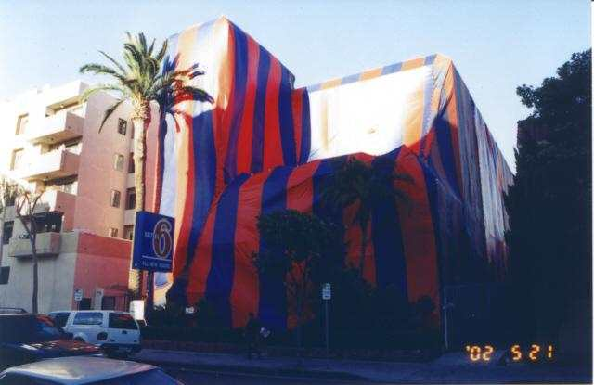
Motto: “We’re just like the big fancy hotels with the lights out.”

Slide 10
Notes:
Coming up exact same time as Lance Armstrong, George Hincacpie, Franki Andreu, Lance Armstrong. Lance and I same age

Slide 11
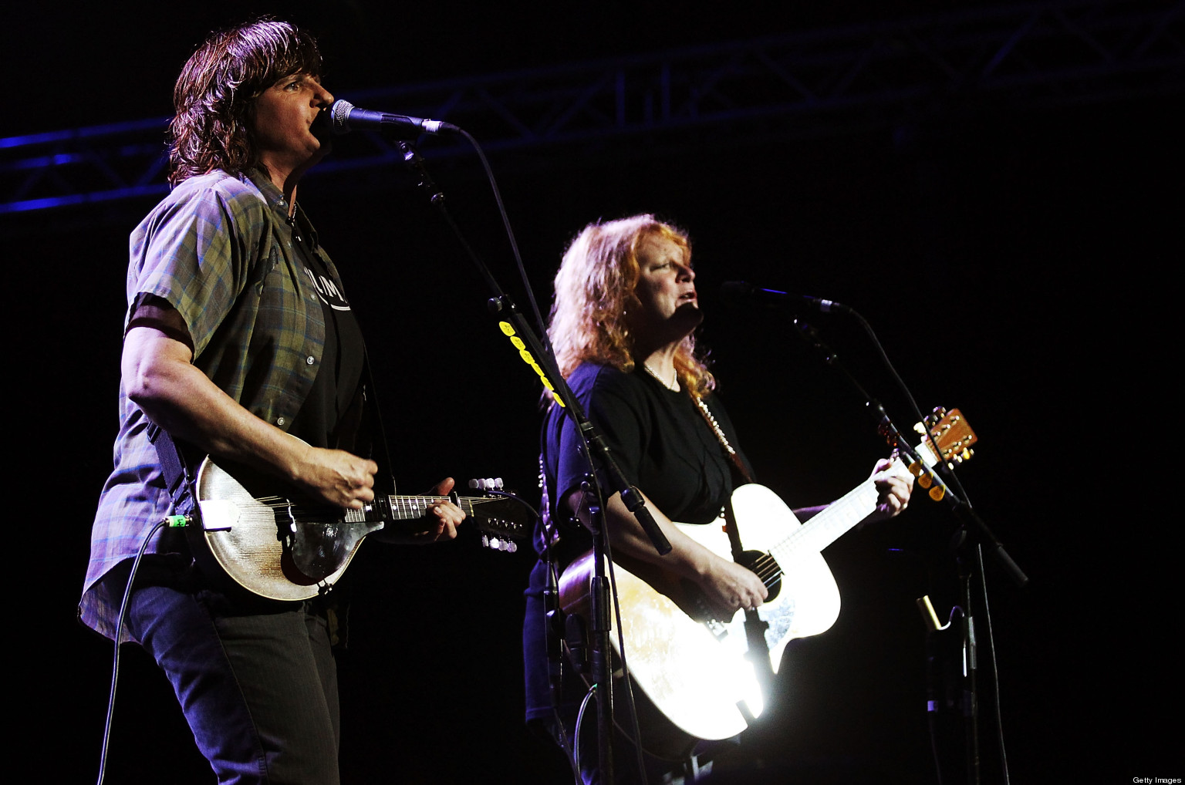
Notes:
National Team – Indigo Girls

Slide 12
Lost 96% of races
Equals win 4%

Slide 13
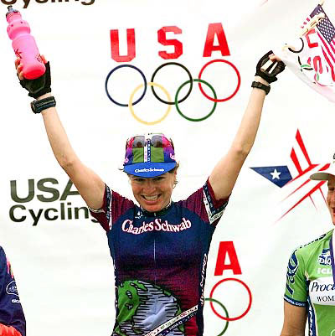

Slide 14
Notes:
Schwab pulled out. Put more into golf.

Slide 15
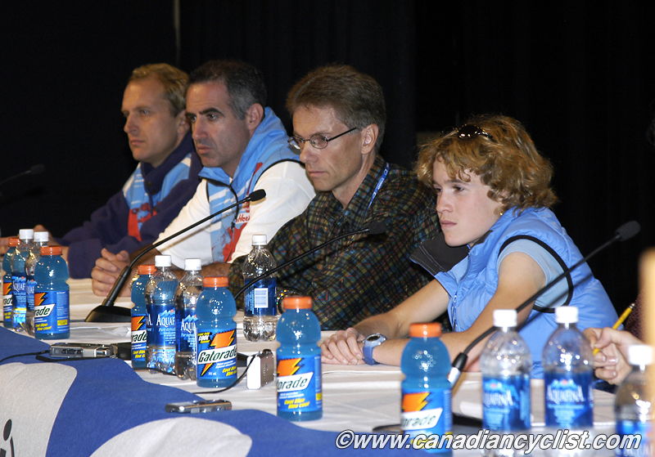
Notes:
Rona teammate 2002.
Started racing 13 FT. Asked 40ish Andre, bball coach @ HS to coach her. He did.
J World RR & TT, 1999. Tour de Snowy in 2000 & La Flèche Wallonne World Cup race. 2000 Canadian Olympic team that year
On team – saw someone stripped of youth. Struggled to have conversation with teammates. Couldn’t go out for dinner during winter training. Lived alone in AZ with coacch.
Andre volatile. Park bench scene. “Don’t talk to me that way again”. Left team despite offer. Amazed others stayed. Older.
Brunt with Andre.
Flung plate across room at her – eating too much.
EPO at 16.
Try to win races, “just to shut him up.”
Scared to death – die of EPO. Sleep and never wake up.
Most serious incident, too exhausted to train in AZ. Stopped. Aubut got so mad, he hauled her off into the desert and hit her. Jeanson said her face swelled up so much, she was unable to put her sunglasses back on.
Married for 6 months to Aubut
Done by 21. Victim. Beautiful person. Sad case. Talented without drugs.
Not uncommon in gymnastics, figure skating. “Little Girls in Pretty Boxes”.

Slide 16
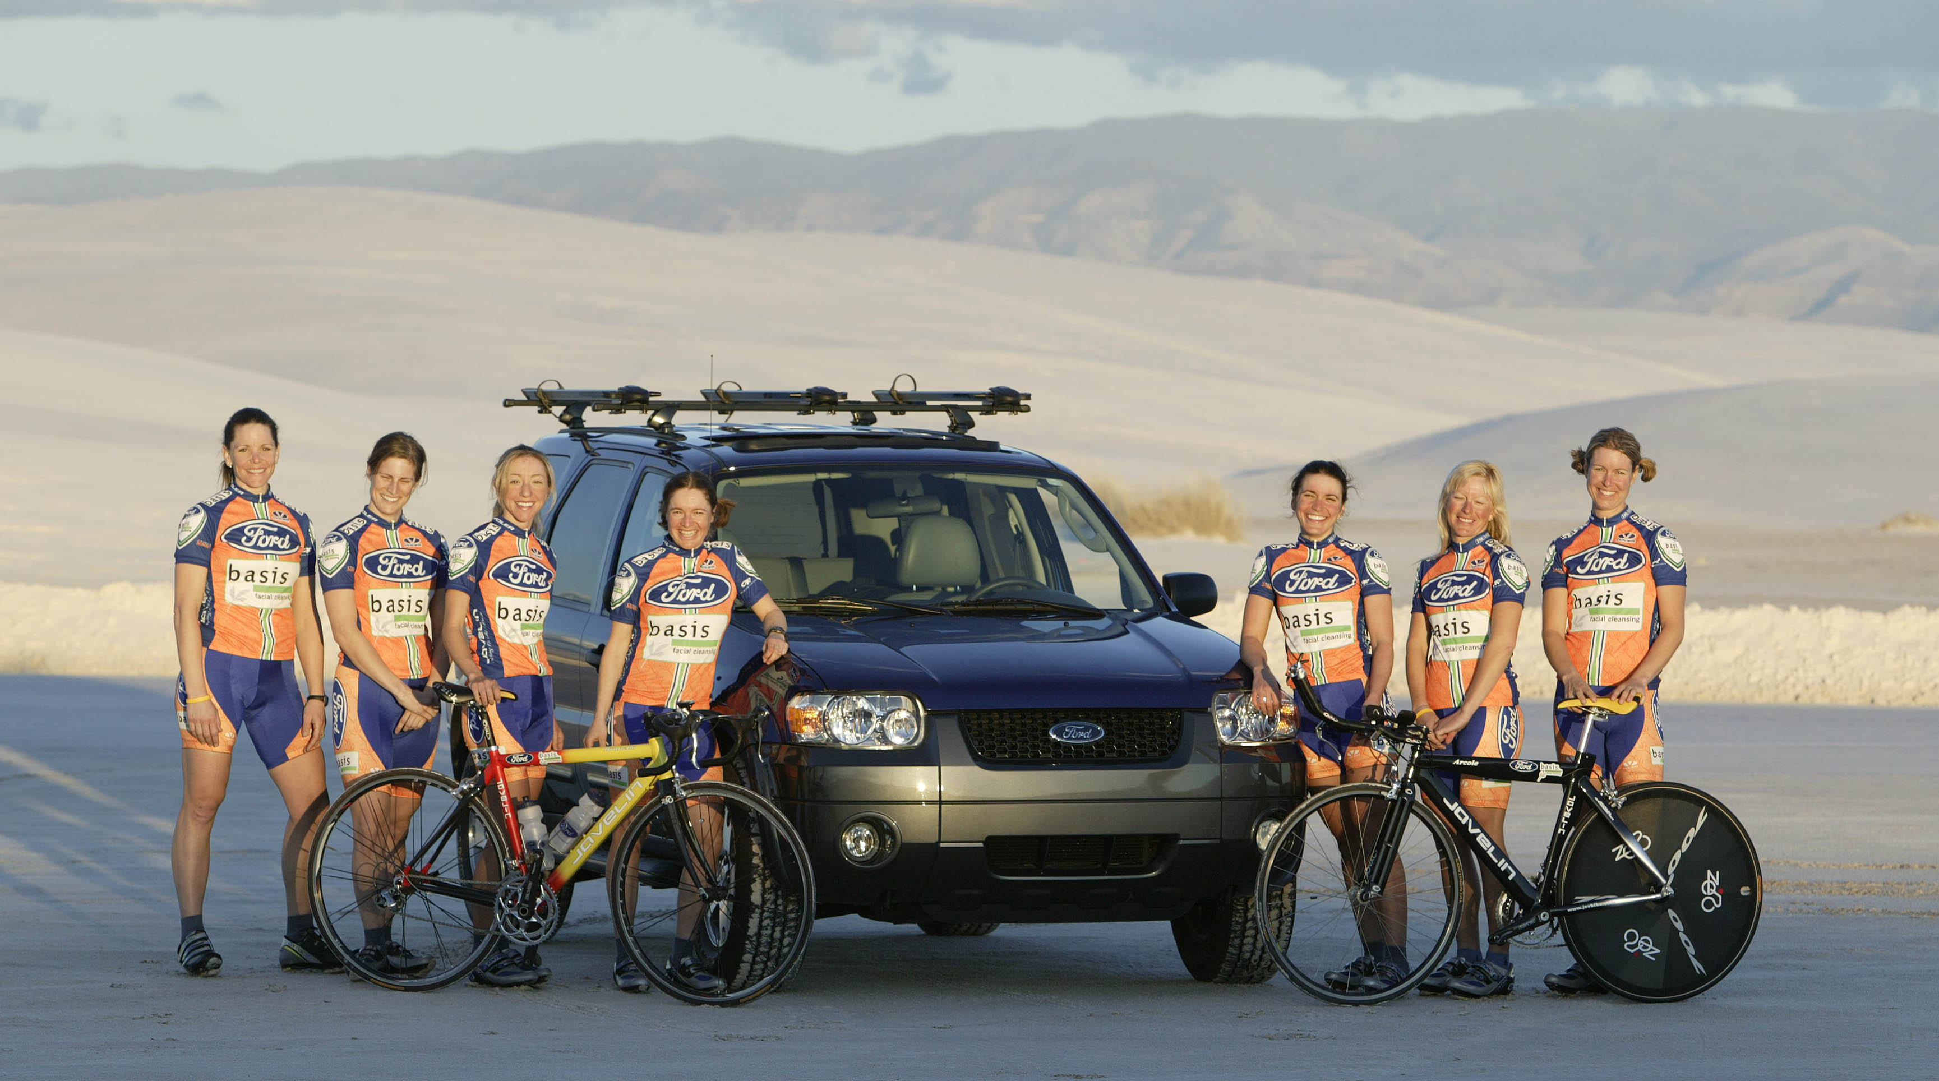
Notes:
Not uncommon. Men run teams of women. Very low barrier to entry. Questinable reasons to want to.
Quit. Nothing else. Ended up forming team. Supportive, nurturing and very, very fun.
Trust that people are training – no forced training.
Post meetings – nobody yell for what diong, everyone say their own thing.
Women owned

Slide 17
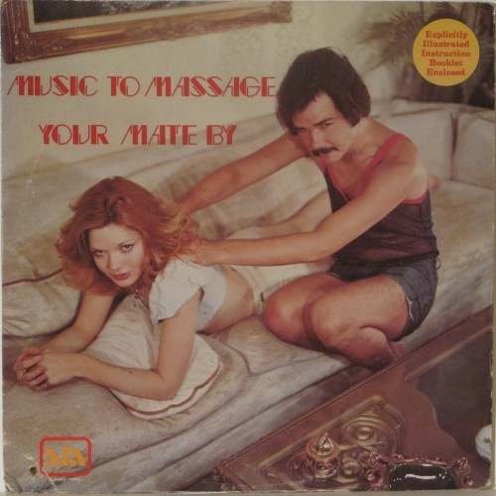

Slide 18
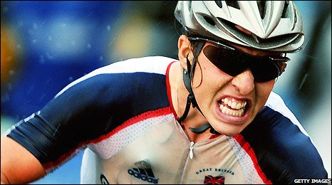
Notes:
Nicole Cooke
Started at 12. Retired 29.
“At the age of 12 one is unaware of the problems ahead. One does not expect that nothing is available if you are a girl It is somewhat of a handicap trying to demonstrate just how good you are on a bike when you are not allowed to ride.”
At 14, no girls British Championship. Forbidden, from senior women's Championship. Jumped in 800M race and won. BCF embarrassed, added race following year.
No youth National Championship or Jr. Technicality, did Senior and on RR. Became SR champion. Opened eyes. British Cycling started races.
Doping: Tempation asked what "medicines" “I said I would do my best until I had to drop out of the race”
This is stealing somebody else's livelihood. It is theft just as much as putting your hand in a purse or wallet and taking money is theft.
Women’s scene has been hit twice. Every scandal on the men's side has caused sponsors to leave on the Women's side.
“They could be more accurately described as criminals who stole other's livelihoods who are only ever genuinely sorry about one thing — they are very sorry they were caught. Tyler Hamilton will make more money from his book describing how he cheated than Bessette or I will make in all our years of our honest labour. “

Slide 19
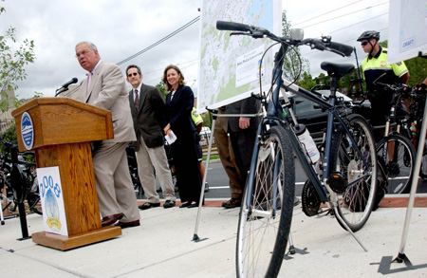

Slide 20
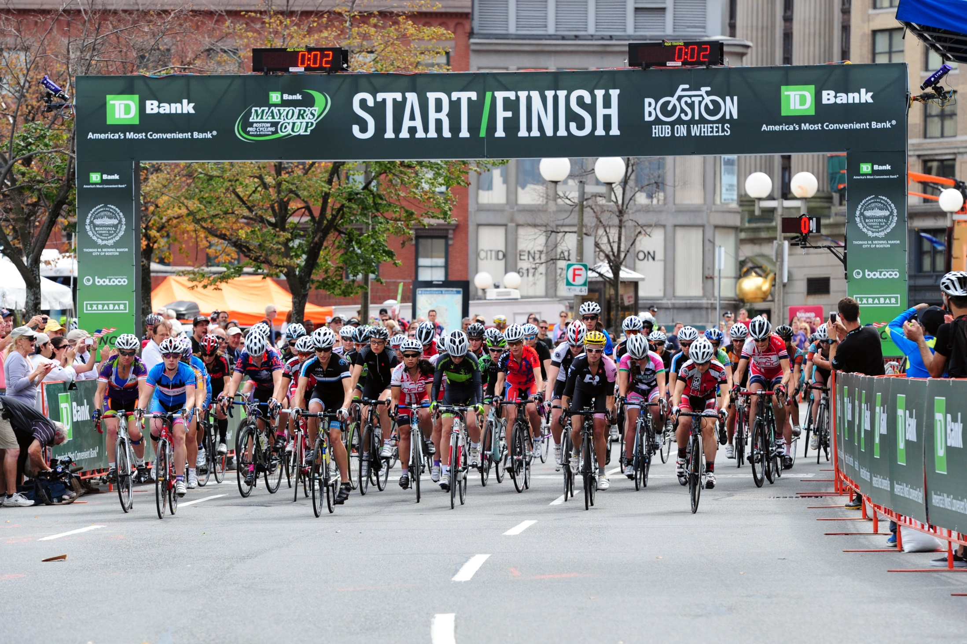
Notes:
Work for City of Boston.
Equal Prize money.
City wouldn’t have it any other way.
Struggle every year to get women to come. Hear – budget done, team won’t pay.

Slide 21
Create Change
UCI Athlete’s Commission
WCA
Start Team
Host Race
Race in leading Women’s races
Cover races in media
Spectate/follow women’s racing
Notes:
Door opening – Image crushed from men doping.
Women’s cycling predominantly clean
DIY
WCA – equality in US. Working with US race organizers and USA Cycling.
UCI Athlete’s Commission – proposed prize lists equal. UCI teams invest in women’s squads. Men’s organizers offer women’s races

Slide 22
Thank you
Nicole Freedman
Director of Bicycle Programs
City of Boston
Nicole.freedman@boston.gov
Notes:
For women – Most talented and dedicated women that can survive lifestyle. Labor of Love.
Career/ Job for men.
I wouldn’t change it for myself. Two years when made most, least happy.

